Slide 1
West Campus
Science Electives
West Campus offers many science electives from which to choose.
Each course has its own set of prerequisites which must be met prior to enrollment.
Students must successfully complete courses in Biology and Chemistry prior to enrolling in these electives.
Most four-year colleges require successful completion of three years of science to be considered for admission.
Students with an interest in the sciences may choose to enroll in more than one science elective at a time.

Slide 2
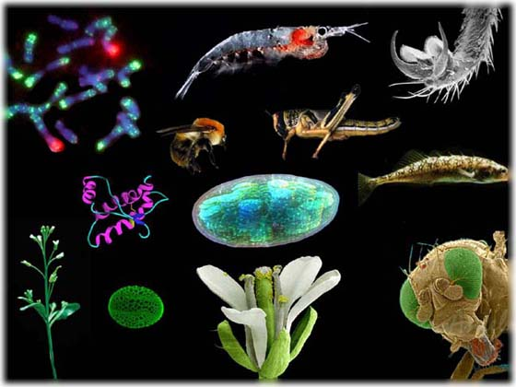
AP Biology- 2 semesters
Prerequisites:
The AP Biology course is designed to be taken by students after the successful completion of courses in high school biology and high school chemistry.
It is suggested that students enrolling in AP Biology have earned a “B” or above in Honors Biology or an “A” in Advanced Biology and a “B” or above in Honors Chemistry or an “A” in Advanced Chemistry . It is also highly recommended that students have successfully completed or are concurrently enrolled in Algebra II.
This course can be taken concurrently with Physics.
Description:
AP Biology is designed to be the equivalent of a two-semester college biology course taken by biology majors during their first year.
After showing themselves to be qualified on the AP Exam, some students, in their freshman year, are permitted to undertake upper-level courses in biology or to register for courses for which biology is a prerequisite. Other students may have fulfilled a basic requirement for a laboratory-science course and will be able to undertake other courses to pursue their majors.
Students will develop advanced inquiry and reasoning skills, such as designing a plan for collecting data, analyzing data, applying mathematical routines, and connecting concepts in and across domains.
The main topics covered are cellular biology, molecular biology, heredity, evolution, plant and animal physiology as well as ecology.

Slide 3
AP Chemistry- 2 semesters
Prerequisites:
Chemistry and Algebra 2; completion of or concurrent enrollment in Physics
It is suggested that students enrolling in AP Chemistry have earned a “B” or above in Honors Chemistry or an “A” in Advanced Chemistry
This course can be taken concurrently with Physics Junior year
Description:
The AP Chemistry course is designed to be the equivalent of the general chemistry course usually taken during the first college year (2 semesters).
After showing themselves to be qualified on the AP Exam, for some students this course enables them to undertake, in their first year, second-year work in the chemistry sequence at their institution or to register in courses in other fields where general chemistry is a prerequisite.
For other students, the AP Chemistry course fulfills the laboratory science requirement and frees time for other courses in college. The emphasis is on chemical calculations and the mathematical formulation of principles, and the kind of laboratory work done by students in college.

Slide 4
AP Environmental Science
- 2 Semesters
Prerequisites:
The APES course is designed to be taken by students after the successful completion of courses in high school biology, chemistry, and algebra.
It is suggested that students enrolling in APES have earned a “C” or above in Honors Sciences or a “B” or above in Advanced Biology and Advanced Chemistry and a “C” or above in Honors Math or a “B” or above in Algebra I or an "A" in Double-Period Algebra.
This course can be taken concurrently with Physics.
Description:
AP Environmental Science is a rigorous course designed to be the equivalent of an introductory college course in environmental science.
Students, who prove they are qualified on the AP Environmental Science Exam, could fulfill a basic requirement for a laboratory science or enable themselves, as first-year college students, a more advanced study of topics in environmental science.
AP Environmental Science will provide students with the scientific principles, concepts, and methodologies required to understand the interrelationships of the natural world, to identify and analyze environmental problems both natural and human-made, to evaluate the relative risks associated with these problems, and to examine alternative solution for resolving or preventing them.
AP Environmental Science has a strong laboratory and field (outdoor) component to ensure that students learn about the environment through firsthand observation.

Slide 5
AP Physics 1- 2 semesters
Prerequisites
An "A" or "B" in Honors Chemistry or an "A" in Advanced Chemistry with a teacher recommendation. In addition, Students should be concurrently enrolled in Algebra 2 or a higher math course. It is recommended that enrolled students have earned a grade of "B" or higher in Honors Geometry, or a grade of "A" in Geometry.
Description
In AP Physics 1, students will discover and test the laws that govern the physical world around them. Kinematics, Circular Motion, Simple Harmonic Motion, Linear Momentum, Work, Energy, Rotational Motion, Electrostatics, DC Circuits, Mechanical Waves, and Sound. This class will also prepare the students to take the AP Physics 1 exam. Students will work in groups and individually to test certain physics principles. During the investigations, students will take part in inquiry-based labs and will utilize high level math skills and computers to analyze data. STUDENTS SHOULD CHECK THEIR PROSPECTIVE COLLEGE TO VERIFY CREDIT AVAILABLE FOR THE AP TEST.

Slide 6
AP Physics C
2 semesters
Prerequisites:
Grade 12
Above average achievement in Advanced or AP Physics 1 and completion of, or concurrent enrollment in Calculus.
Description:
Advanced Placement Physics C is a second-year physics program for students who desire a college-level course while still in high
school.
The content emphasizes problem-solving in mechanics. Advanced mathematics, including calculus, will be used.
Satisfactory completion of Advanced Placement Physics C will prepare students to take the Advanced Placement Physics C mechanics examination.
This course is designed for students interested in such careers as engineering, physics, astronomy, biophysics, and mechanical design.

Slide 7
2 semesters
Prerequisites:
Biology and Chemistry
Recommended: Successful completion of Honors Biology and Honors Chemistry, an “A” or “B” in Advanced Biology and Advanced Chemistry, or an “A” in Biology and Chemistry.
- This course can be taken concurrently with Physics Junior year
Description:
Anatomy and Physiology is a course designed for students who would like a more in-depth study of the human body. Emphasis is placed on the body’s organizational structure and function.
Laboratory work is an integral part of the course, including an emphasis on the body systems, various organ dissections, and the culmination of the fetal pig dissection.
Students contemplating a career in a health-related field should consider this course.

Slide 8
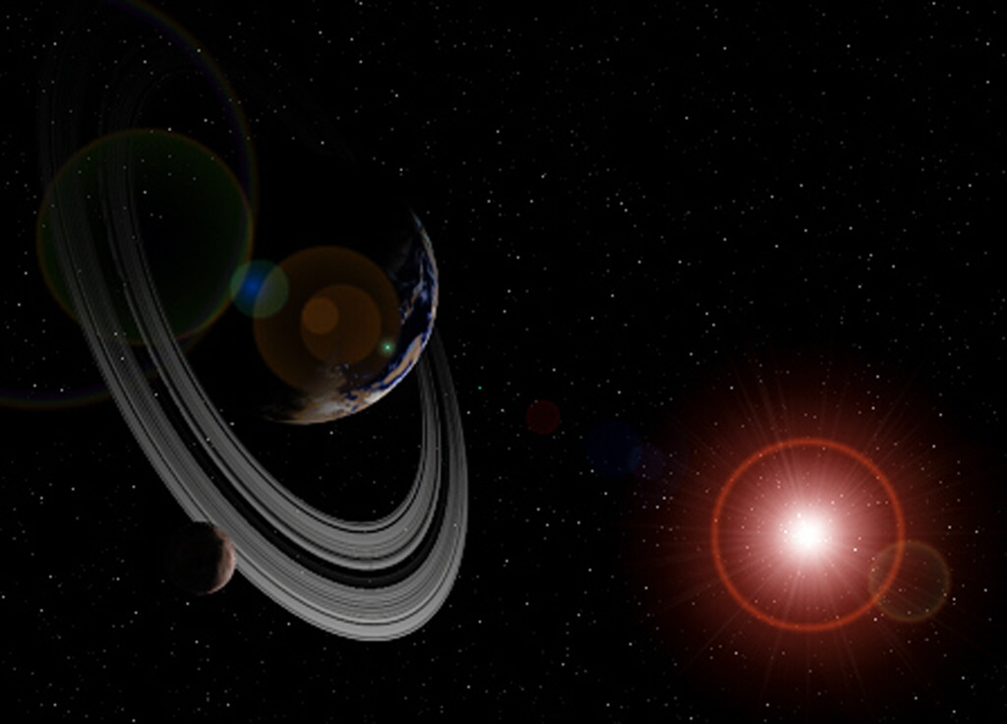
Astronomy
1 semester
Prerequisites:
Two years of science and two years of mathematics
Recommended: Strong knowledge of physics or concurrent enrollment in Advanced Physics
Description:
This course provides an outlet for talented science and
mathematics students who have an interest in astronomy.
This course provides a practical application of concepts from physics, earth and space science, and mathematics courses currently taught at Lake Park.
Evening observation/laboratory periods are encouraged.

Slide 9
1 semester
Forensic Science
Prerequisite:
Successful completion of one year of science
This course can be taken concurrently with Advanced Physics Junior year
Description:
Forensic Science will introduce the student to the world of forensic science and crime scene investigation.
This course is designed to cover topics in biology, chemistry, earth science, and physics.
The focus of this course will be real-life scenarios implemented in the laboratory.
Students will be expected to think critically, apply theory, analyze data and draw conclusions to solve simulated crimes.

